Slide 1
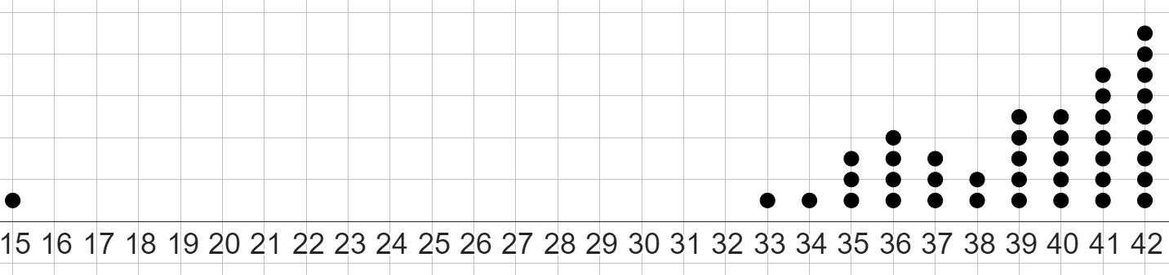
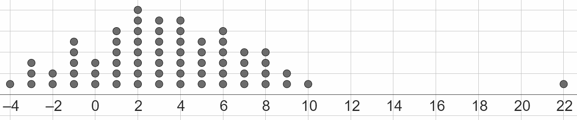
Evaluating the range
Task A: Outliers and their effect on the range
1)
a) Circle the outlier in this dataset.
b) What is the original range of this dataset? The range is 27
c) If a data point for the number 39 was removed, by how much would the range change? Explain your answer. Would not change, as 39 is neither the smallest or largest data point.
d) Remove the outlier from the dataset. Calculate the new range. 42 - 33 = 9 The new range is 9
2)
a) Circle the outlier in this dataset.
b) What is the original range of this dataset? The range is 26
c) If a data point for the number -4 was removed, by how much would the range change? Explain your answer. The range would decrease by 1 to 25 This is because −4 is the smallest data point.
d) Remove the outlier from the dataset. Calculate the new range.
10 − (−4) = 14 The new range is 14

Slide 2
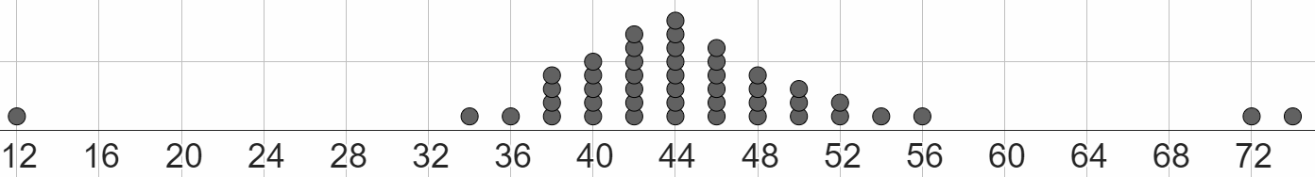
Evaluating the range
3) All data points in this dataset are even numbers.
a) What are the values of the three outliers?
12, 72, 74
b) By how much would the range decrease by if all the outliers were removed?
The range is currently 62
Without the three outliers, the range would become:
56 - 34 = 22
The range would decrease by 40
1.5 | 14.5 | 16.9 | 21 | 24.2 | 28.3 | 31.9 | 33.8 | 37.7 | 38.8 | 39.9 | 42.5 | 45.2 | 46.8 | 82.5
4) Complete each sentence with a number from the dataset:
the original range is 81
removing the data point 37.7 will change the new range to 81
if the smaller outlier was removed from the original dataset, the new range would be 68
if the larger outlier was removed from the original dataset, the new range would be 45.3
the outlier that would be more impactful to remove is the larger outlier: 82.5

Slide 3
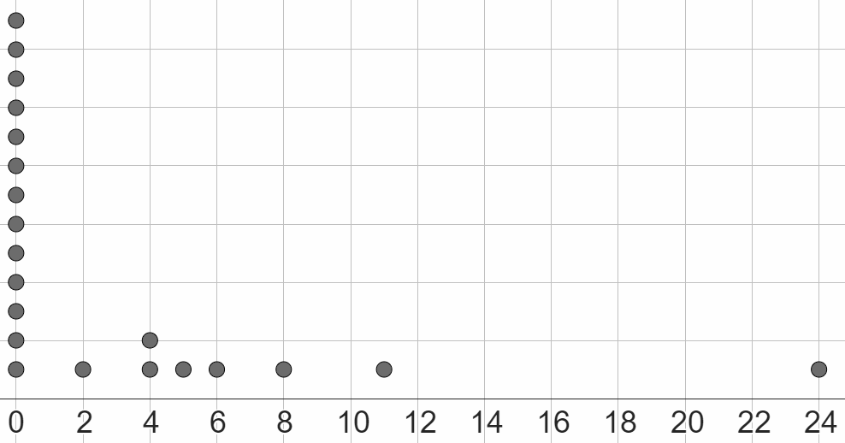
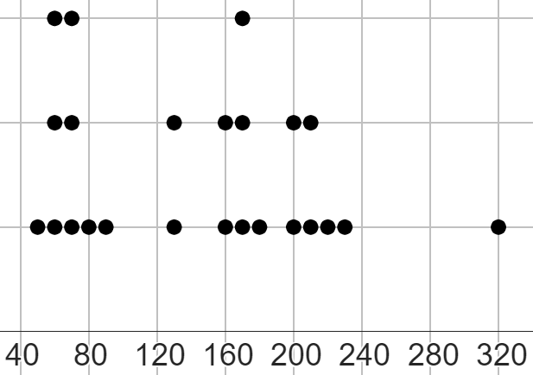
Evaluating the range
Task B: Evaluating if removing outliers is sensible
1) This dot plot shows the number of days per month that had airfrost (due to cold weather) in Leuchars (Scotland) over a 21 month period.
a) What is the value of the outlier?
24 is the outlier
b) Should the outlier be: removed, kept, or investigated further?
Write a sentence to explain the option you have chosen.
Investigate further, as it is unclear whether the outlier is an error, or just a very cold month.
2) This dot plot shows the number of “hours of sunshine” per month for two years, rounded to the nearest 10 hours.
a) What is the value of the outlier?
320 is the outlier
b) All data points have been correctly measured, with no error.
Should the outlier be: removed, kept, or investigated further?
Write a sentence to explain the option you have chosen.
The outlier should be kept, as this month might have just been a very sunny month, and this information needs to be represented.
3) This dataset shows the height of 24 chimpanzees, in centimetres.
1.4 | 95 | 103 | 108 | 108 | 111 | 114 | 117
118 | 118 | 124 | 125 | 129 | 132 | 135 | 138
130 | 138 | 150 | 153 | 161 | 166 | 172 | 198
a) What is the current range of this dataset?
196.6 cm
b) What is the value of the outlier or outliers in this dataset?
1.4 is an outlier
198 may be an outlier, but this is unclear.
c) Should the outlier or outliers be: removed, kept, or investigated further?
Write a sentence to explain the option you have chosen, and justify it by calculating any new range that might happen from you removing any outliers.
The outlier of 1.4 should be removed, as this is very clearly an error. Perhaps this measurement was made in metres, not centimetres. The range would decrease to 103. The data point of 198 needs to be investigated further, it might just be a very large chimpanzee!

Slide 4
Evaluating the range
4) This dataset accurately shows the total monthly rainfall (in millimetres) each month for two years, between 2007 and 2008.
285.6 | 60
154 | 58.3
146.9 | 57.5
113 | 56.7
108.7 | 52.8
98.8 | 48.7
93.2 | 44.5
92.4 | 43.5
83.8 | 28.1
82.6 | 27.1
79.2 | 23.3
74.9 | 5.8
Jun wants to represent this dataset on a dot plot, and wants to see if removing any outliers has an impact on the range of the data he has to plot.
Calculate two ranges, with one keeping the outliers, and one removing an outlier, and suggest if Jun should represent all data points on a dot plot or not.
original range = 279.8
If the outlier of 285.6 is removed from the dataset, the new range becomes 148.2
Jun should omit the outlier from the dot plot, as the range nearly halves without it. However, the outlier should still be acknowledged, in case that month was just very rainy!
Mathematics in Education and Industry
v2.2

